Slide 1
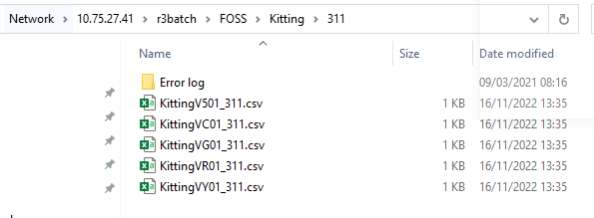
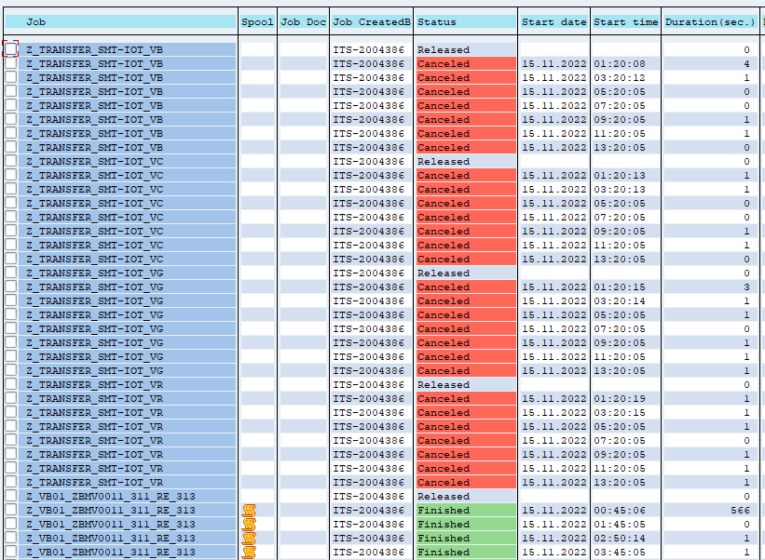
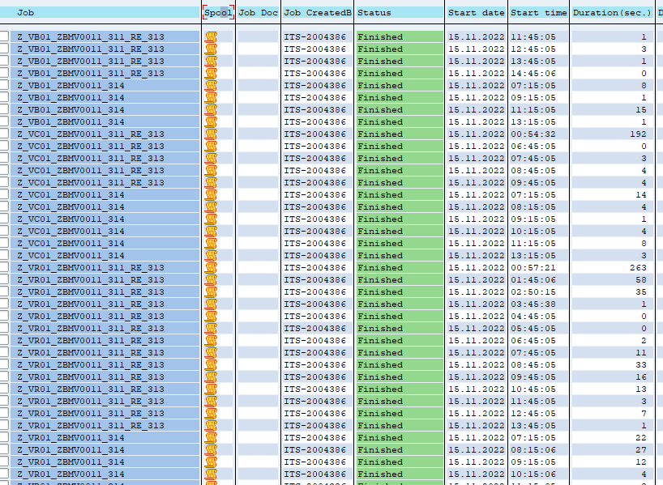
Reduce server resource by stop useless auto-job in SAP
1/1
Stop useless auto-job by using Hulft ID event.
Developer: SAP team
Apply: Nov.2022
Expn: 0
◆Before
◆ After
SAP Job only execute
once exist data on server.
File has no data, SAP job still execute.
File has no data, job still execute.
No more useless auto job
Many useless auto job
Exist data file on server, SAP Job will be executeds (on scheduled time) – even the file has no data.
Lose the unnecessary bandwidth.
(might effect other SAP Job)
Only if the file has data.
→ SAP job will execute.
Don’t lose the unnecessary bandwidth.

